Slide 1
CSDP-499 Codrone Sim
Week #3
Nyles, Muna, Ali, Success, Sopuru

Slide 2
Intro
This project is student project where our goal is to create an unreal simulation of a drone controlled through a python script in an unreal simulation.
- Education
Recreation
Test run of a product

Slide 3
R1 Interagator - Muna
Task: Sprint Leading
Sprint planning with Stories
Sprint Retrospective and Review

Slide 4
Build - Ali
Role Responsibilities
• Ensure the project can run on another machine
• Maintain the build status documentation
Work Completed This Week
• Packaged the Unreal Engine project into a Windows development build
• Verified the packaged build runs successfully on the Golden Machine
• Verified the build runs on a secondary machine
• Created a downloadable build artifact (GitHub Release)
Build Artifact
• Windows packaged build available via GitHub Release
Result
✔ Reproducible build workflow established

Slide 5
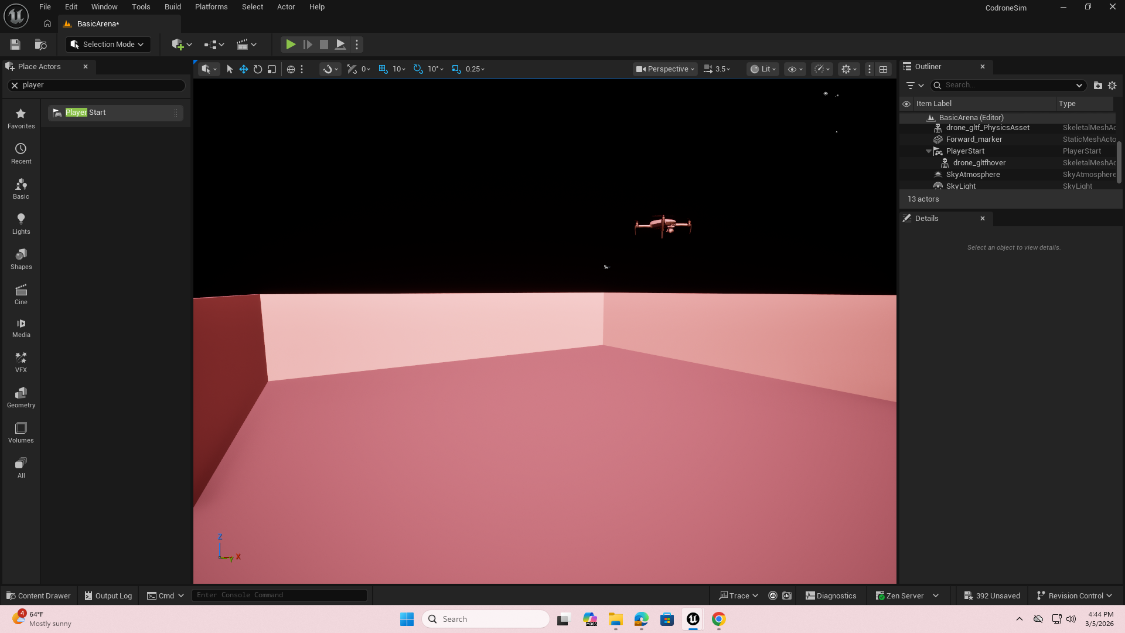
R3 World - Success
Create/acquire a drone model and give it a spawn point
- Attaching a 3rd-person camera for the drone

Slide 6
R4 API\SDK - Sopuru
Task:
Set up SDK in The project
Created the test old_model branch to verify how it functions
Etc…

Slide 7
R5 SDK - Nyles
Task:
Create Python script that handles user commands.
Create the output folders "run" and the command csv(s)
Task:
Implement the commands: close(), statePulling(), takeof(), hover() and land()

Slide 8
Retrospective
What Worked:
Documentation on Airsim is more abundant than we thought.
A lot can be done in Unreal without writing a single line of code
What Didn’t Work:
Microsoft Air sim was going to continue being a challenge:
Older and out of date.
Need to use python 3.9 and Unreal 4.27
Project AirSim fixes this
Still being supported
Works with modern unreal

Slide 9
Deliverables
docs/sprints/W03/plan.md
sdk/UserControl.py
3d Drone Model inside Project
Updated docs/Protocols.md(to reflect actual implemented Messages)
runs/startup.json
runs\RunCommands\Run_0_Commands.csv
Docs/presentations/W03_PRESENTATION.pptx
In old_model branch : sim/Codrone4.27/TestAirSim3/Plugins/Airsim

Slide 10
What we plan to change next sprint
Migrate to Project AirSim
The Successor to Microsoft Airsim Managed by IAMAI.
That’s pretty much it!!

